Slide 1
Problem Description
The Longest Path Problem can be defined formally as follows:
Given an undirected graph G(V, E) with n nodes, the nodes s and t ∈ V and a positive integer k, the longest path problem asks to compute a simple path that exists between s and t in G which contains at least k edges
In short:
Our NP-Complete Problem : Longest Path
Input: n-node undirected graph G(V, E); nodes s and t in V; positive integer k.
Our Question: Is there a simple path between s and t in G that contains at least k edges?

Slide 2
Hardness of our problem:
Longest path problem is a NP - Hard problem for a general graph.
However, the question “Is there a simple path between s and t in G that contains at least k edges?” is a part of NP - Complete class of problems.

Slide 3
Proof of Longest Path Problem is a NP-Complete Problem :
In order to prove a problem is NP-complete problem:
the problem needs to be shown as a part of NP
it should be reducible to a NP-complete problem in polynomial time.
The proof of the Longest Path problem is a NP – Complete problem can be done by reducing the Hamiltonian path problem since the most natural optimization version of Hamiltonian path problem is the Longest Path problem(Mertzios et al., 2010).
Hamiltonian path problem is a problem
of determining whether a path in a graph that visits each vertex exactly once exists in the given graph.

Slide 4
A graph G(V,E) has a Hamiltonian path, if and only if its longest path has length of n − 1, where n is the number of vertices in G.
Given a solution path P, the statements below should be verified:
P consists of at least k edges
These edges form a path.
For every edge, an augmented graph can be constructed such that it consists of G and two additional verticies
These verifications hold for every edge in E. The reduction follows directly from Hamiltonian Path and the verifications above can be done in polynomial time. O(n^{k} )

Slide 5
Given an instance of Hamiltonian Path on a graph G = (V, E). An instance of the Longest Path problem can be generated G', k as stated below:
The same graph is used such that G' = G
Set k for Vertex Cover = |V | − 1.
By adding two edges in G’ for every edge in G, we claim that V’ is a vertex cover of G if and only if V’ is a feedback vertex set of G’.
Given a vertex cover V’ of G, every edge {u, v} ∈ E must be covered by a vertex in V’. That is, every edge in E has at least one of its endpoints in V’.
Thus, G’ does not contain a cycle. In a feedback vertex set V’ of G’ every cycle in G’ must contain at least one vertex from V’. Every cycle of length 2 in G’ must contain at least one vertex from V’. Every cycle of length 2 corresponds to an undirected edge in G.
Thus, every undirected edge in G has at least one of its endpoints in V’ and thus V’ is a vertex cover for G.
Therefore, there exists a simple path of length k in G' if and only if G' contains a Hamiltonian path.
Since the Hamiltonian path problem is NP-complete, the reduction shows that the decision version, the question version of the Longest Path problem is also a NP-complete problem.

Slide 6
What does algorithm do?
We create a random graph with given number of vertices
Generate random edges between vertices with Erdos Renyl algorithm
Removes the weakly connected edges
Chooses a k between (1, V) and tries to obtain a longest simple path including k edges by:
First applies DFS on strongly connected edges
Then applies topological sort on the stack observed from stack
Now we have a path, it checks if it is bigger than current path, current path is replaced.

Slide 7

Algorithm Analysis

Slide 8
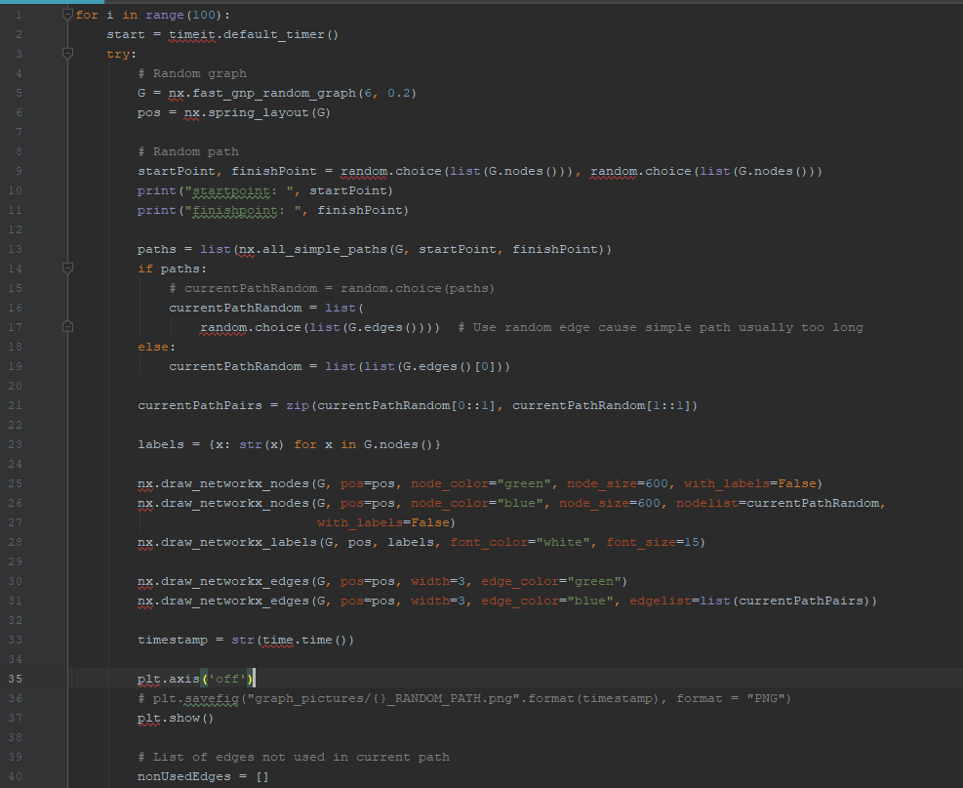
since it is constant : O(1)
First Part of
The Analysis:
O(V+E) time complexity
A single path can be found in (O(V+E)) time
but the number of simple paths in a graph can be very large, e.g. (O(V!)) in the complete graph of order V.
Position nodes using Fruchterman-Reingold force-directed algorithm. See next page for details
O(V²) for regular,
O(V) for sparse and uniformly distributed (vertices) graphs.
O(V)
O(V+E)

Slide 9
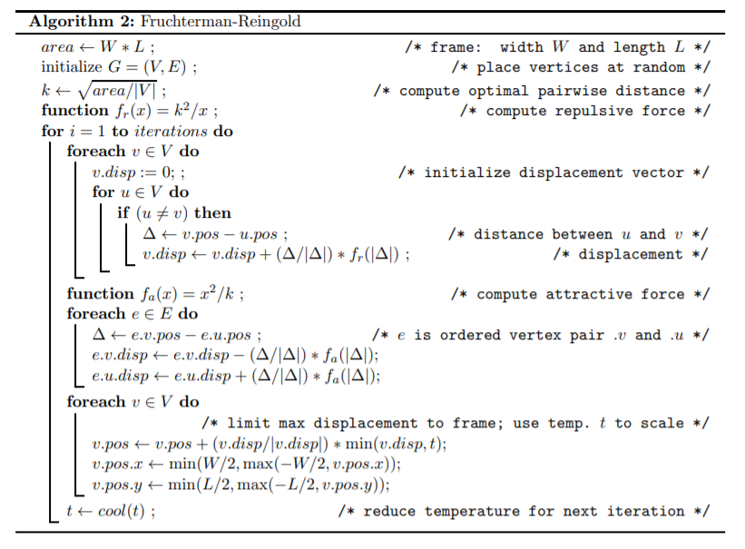
https://arxiv.org/pdf/1201.3011.pdf

Slide 10
Fruchterman - Reingold Algorithm:
Each iteration of the basic algorithm computes:
O(|E|) attractive forces and
O(|V|² ) repulsive forces.
To reduce the quadratic complexity of the repulsive forces, Fruchterman and Reingold suggests that:
Using a grid variant of their basic algorithm, where the repulsive forces between distant vertices are ignored.
For sparse graphs, and with uniform distribution of the vertices, this method allows O(|V|) time approximation to the repulsive forces calculation.
https://arxiv.org/pdf/1201.3011.pdf

Slide 11
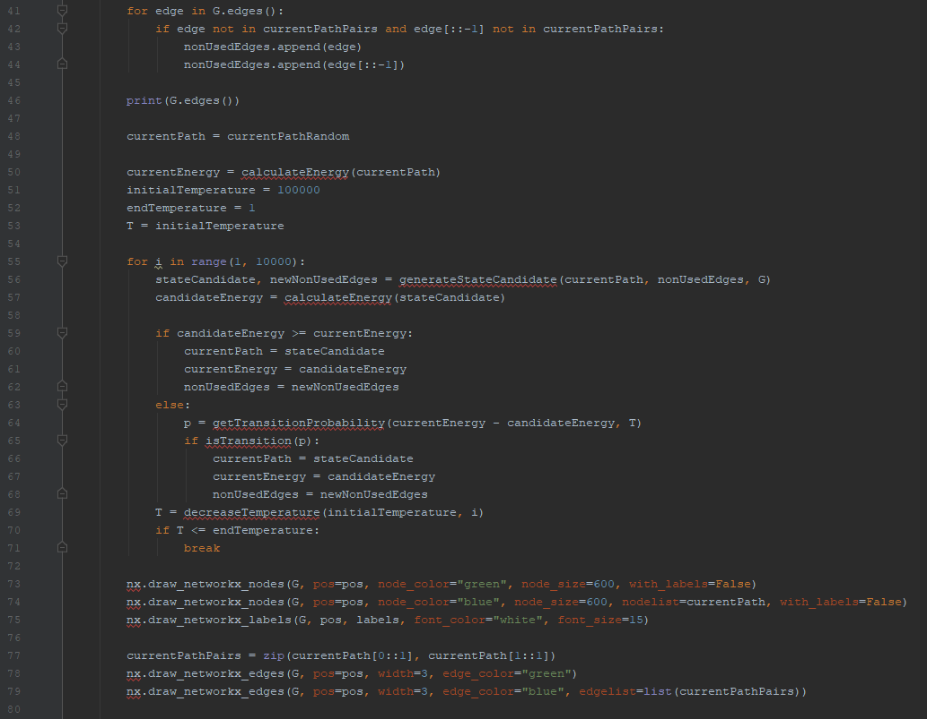
O(E)
Second Part of
The Analysis:
O(V)
O(1)
O(E³V)
O(V)
Loop = O(E³V)
O(1)

Slide 12
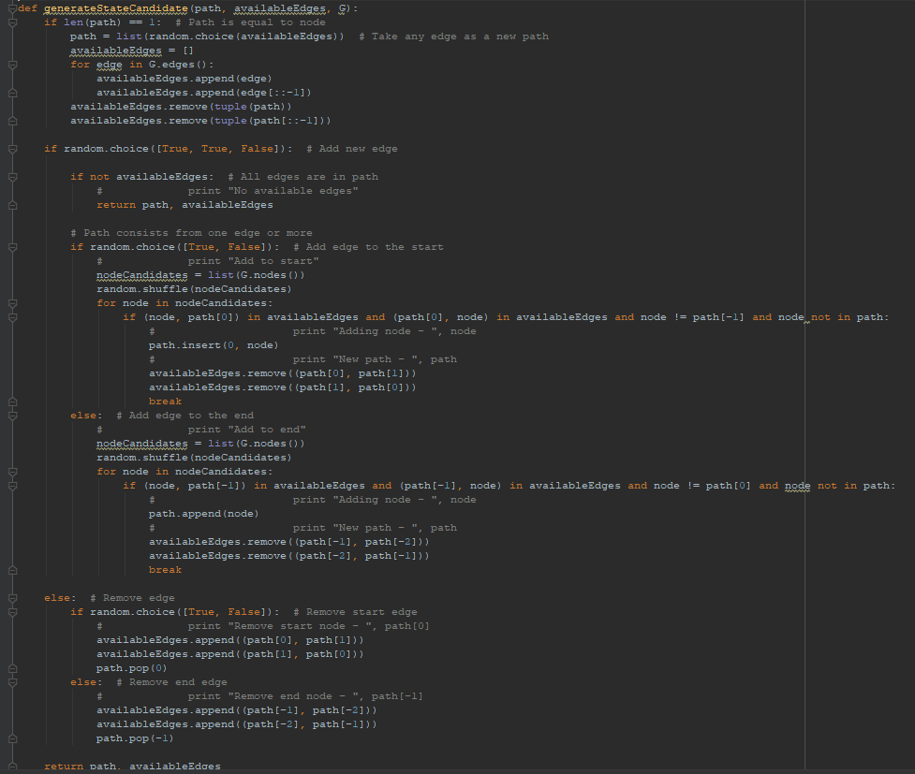
GenerateStateCandidate Function Analysis
O(E)
O(E)
O(V)
O(E³V), Loop and if statement
O(E³)
Total complexity of function is: O(E³V)
O(E³V), Loop and if statement

Slide 13
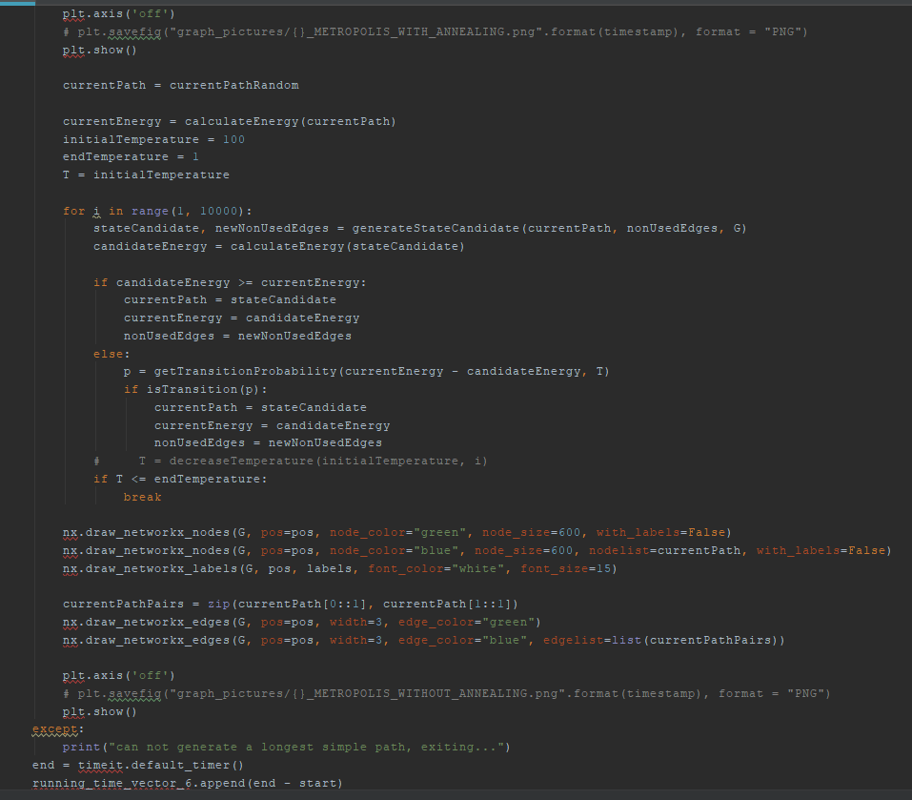
Third Part of
The Analysis:
O(E³V)

Slide 14

Time Complexity
In general, for sparse graphs, and with uniform distribution of the vertices :
Time complexity is: O(VE³)
For other graphs, it is O(V²+VE³)

Slide 15
Experimental Analysis – Average Success Rate

Slide 16
Success Rate

Slide 17
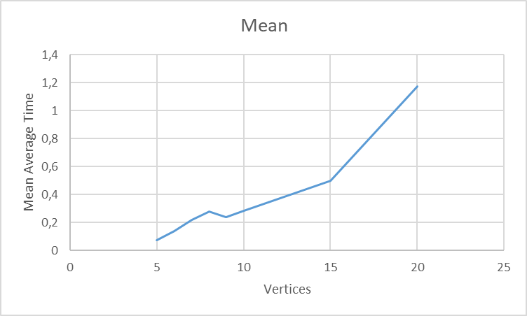
Experimental Measurement of Running Time for 100 Instances

Slide 18
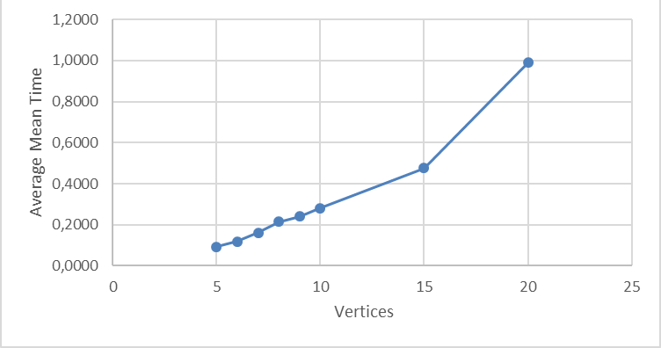
Experimental Measurement of Running Time for 200 Instances

Slide 19

Experimental Measurement of Running Time for 500 Instances

Slide 20
Testing
For testing, we used blackbox testing with randomly generated (according to Erdos Renyl Model) graphs within the algorithm. Also the source and target vertices are picked randomly.
Blue edges construct the longest simple path that is found
Green edges are remaining edges.
Some results are stated in the next few slides.

Slide 21
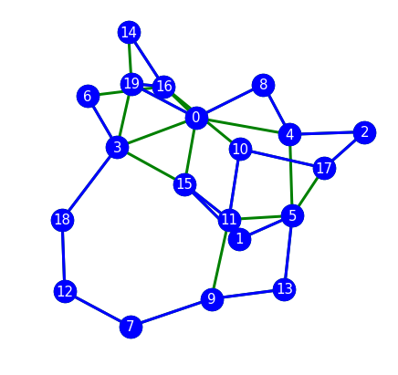
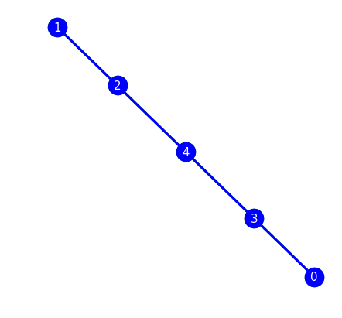
Some Results

Slide 22
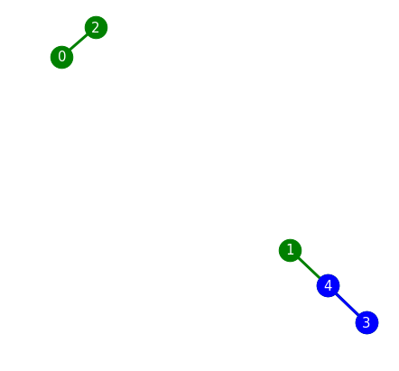
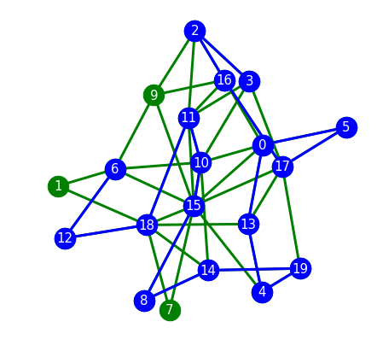
Some Results

Slide 23
Conclusion
The longest path problem for general graphs are NP-hard but our specification of the problem is NP-Complete
There is no polynomial time algorithm that solves the longest path problem efficiently. Our algorithm is a heuristic approach to the solution based on brute force.
Considering the results, success rate depends on the randomly generated graph.

